Slide 1

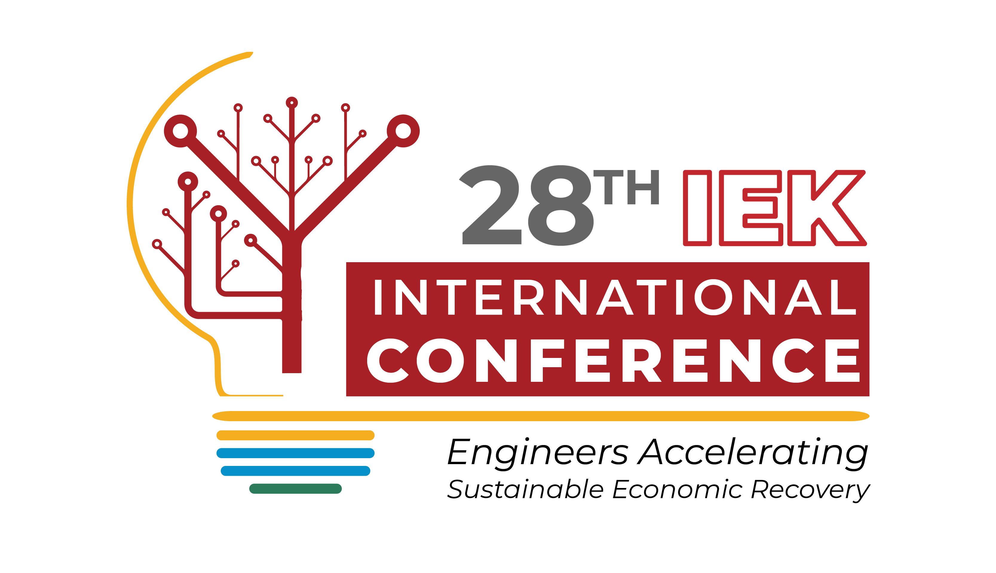



TOPIC:
SMART HOME AND INDUSTRY
Hosted by:
PRESENTER: Brian Ngumi Mundia

Slide 2

Abstract
Daily human interaction involves convey in transmission of impulses via basic biological channels; such as touch, or speech; this can be cultivated into Industrial and Domestic device utility by linking a smart instruction recognition framework which enables control of devices by a wide range of users in society including members of the paraplegic, hearing and speech impaired community, where speech and touch control respectively enables them also be part and parcel in device control

Slide 3

Introduction
Tactile as well as speech is in great demand because it offers an easier control for a large variation of individuals of society ranging from the blind and physically challenged to as well as those of old or young ages of a select gender; this would increase convenience in electrical or electronic appliance control accessibility by a greater factor.

Slide 4
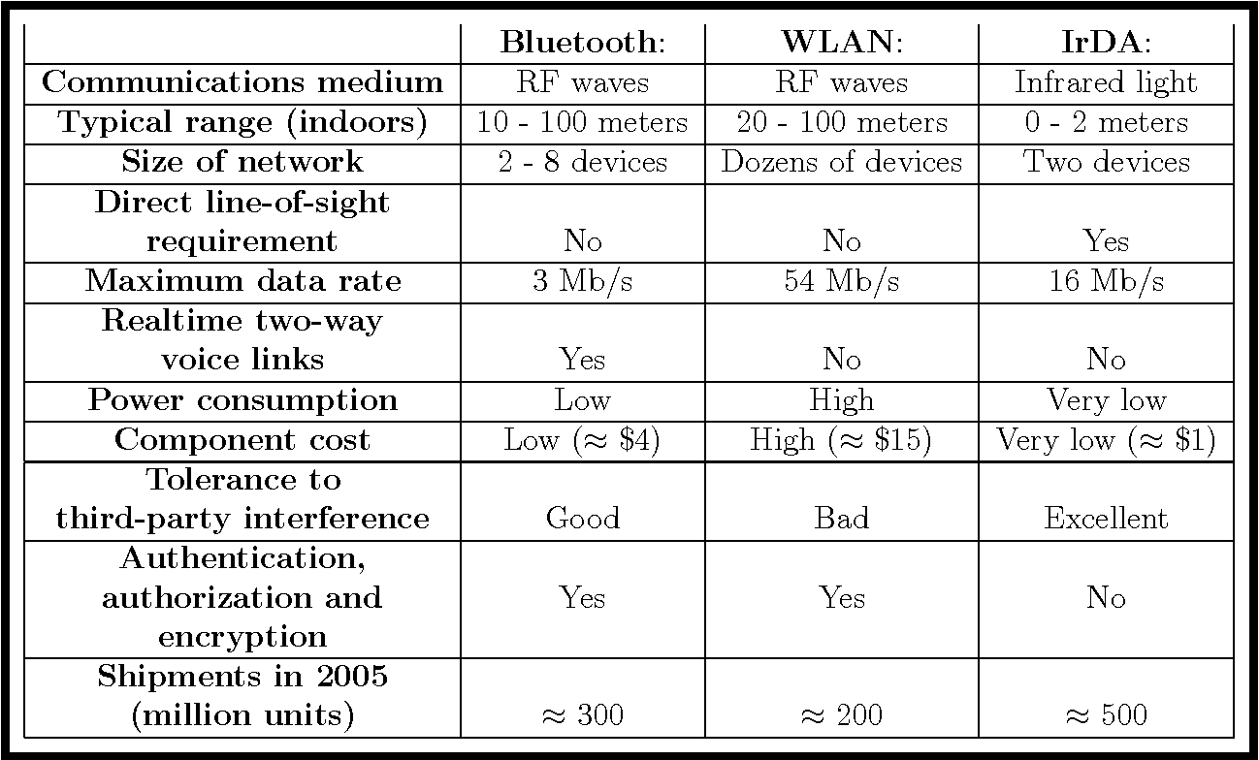
Discussions
In a research done (Haataja, 2007), the differences between Bluetooth, WLAN and IR technologies is outlined as follows;
Elster, R. S. (1980) also points out that speech conversion gives a result of about 86% effectiveness with a room noise level of 34.5-dB through remote testing using Bluetooth which is functional in the distance between 1 - 20 m.
From the evident indications pointed by the research, in relation with observations indicated in Table 1, the prototype is built utilizing Bluetooth and IR due to their high tolerance to third party interference, typical device communication range and their relative cost.

Slide 5
Methodology
User control with a smart home or industry device is realizable through controlling electronic devices by using voice command or touch control from the user or smart home owner. This actualization using remote voice or touch control with a device could make it easier for users to carry out daily activities through a predefined code.
IR AND BLUETOOTH CONTROL COMBINATION REALIZATION
Approaches illustrating on actualization in device control using A:
Bluetooth control transmits speech commands translated into text based application with support for up to 8 devices
Device implementation procedure based on Arduino Control with predefined code: When any button of the remote is pressed, the IR LED of the remote sends a unique encoded signal

Slide 6
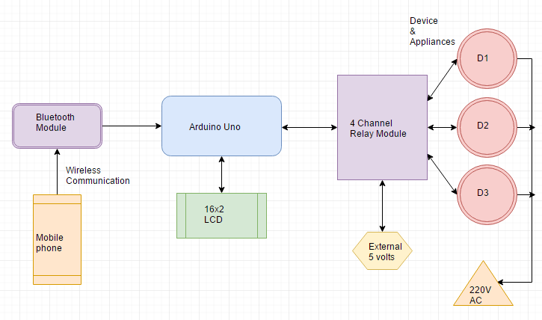
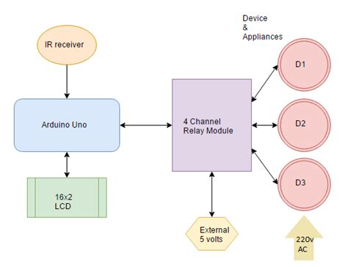
Device control
a. Speech - Bluetooth Control
b. Touch - Infrared Control
Device control via Bluetooth
The end user control consists of a combination of google voice API and the AMR voice interception app which understands the voice commands. The Arduino Bluetooth control serves as the touch-base application with support for up to 8 devices.
Device control via IR control
When any button of the remote is pressed, the IR LED of the remote sends a unique encoded signal. The TSOP1738 IR Receiver sensor receives this signal and send it to the Arduino. Then the Arduino decodes the signal and converts it into a hex value, and store the value into the variable.

Slide 7
Results
Observation from alternative device control methods via Bluetooth
Table 1
Method | Flexibility | Robustness | Security | Cost | Response time
1 | The System is trained according to the user thus is flexible. The method is highly adaptable to any environment because of low requirements | A dedicated microphone is 60% accurate when noisy and 80% - quiet Accuracy without using a dedicated microphone is 30% - noisy and 60% - quite | No security issue Addressed. | Only Arduino UNO the cost is minimal | Time taken to execute a command for a distance between 10-15 meters is 145milliseconds
2 | The system is flexible as it uses open source applications from the android play- store thus adding to the Database while learning commands and referring To files from All over the world | Robustness depends on OS, company of the mobile and quality. Even after that the system performance is 87% accurate. Noisy environment mildly affects the system. | Secure protocols are used over the internet as it uses google APIs. | The need of mobile devices of the user drastically reduces the hardware cost and only requires basic modules to make the environment smart. Thus, less costly. | With a Bluetooth range of up to 20meters, the system performs within 1 to 3 seconds with a good internet connection and maximum 5 seconds with slow internet. Response time is above average.
3 | Flexible; voice recognition module trained for various demographics can adapt to any environment. | Accuracy in silent condition 60%. Accuracy in noisy conditions 80%. | Channel is secured before transmission presumes. High security. | Cost is minimal; a single micro-controller and speech recognition module is utilized. | Average response time

Slide 8
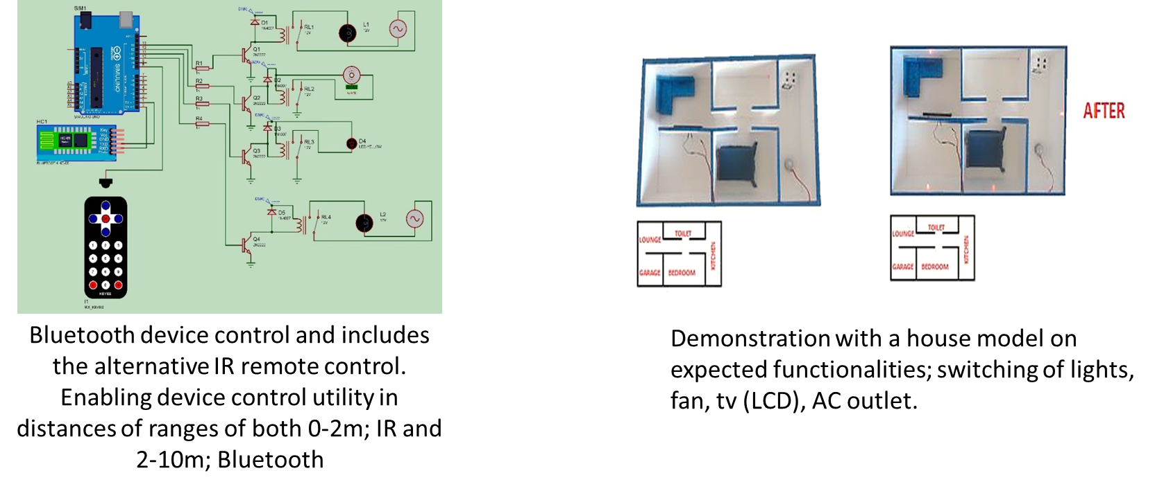
Results

Slide 9
Conclusion
This paper has illustrated realization of two modules to achieve speech and touch control in relation with the relevant mentioned factors ;
The first module being used for Bluetooth control using speech recognition system, this module provides speech to text conversion via the open source google cloud and relays commands to the Arduino through a Bluetooth communication channel.
The second module illustrates IR decoding and relay of instruction implementation via the Arduino IDE.

Slide 10
Acknowledgement
I wish to thank:
Mr. Mrima, my project supervisor, for his valuable guidance towards actualizing my project.
Douglas Mbaka, for his relentless dedication in ensuring my classmates and I understood any mind-boggling concepts during the laboratory practical sessions.
Ron Ohuru, for introducing me to myriad information on Arduino programming.
Ziri Issa, for enabling me acquire relevant information and access a valuable information community space.
Techbridge and Close the gap, where I intriguingly permanently began changing my technological mindset into the future.

Slide 11
References
C. S. Tyagi, M. Agarwal, and R. Gola, “Home automation using voice recognition and Arduino,” Journal of Recent Trends in Engineering & Research, vol 2, no. 7, pp. 1-6, July 2016
Elster, R. S. (1980). The effects of certain background noises on the performance of a voice recognition system (Report No. NPS54-80-010). Monterey, CA: Naval Postgraduate School. (ADA106138)
Haataja, K. (2007). Security in Bluetooth , WLAN and IrDA : a comparison: https://www.semanticscholar.org/paper/Security-in-Bluetooth-%2C-WLAN-and-IrDA-%3A-a-Haataja/c964fa281578ebde0bb66410c73599da054edfa3#paper-header [Accessed 22 Sep. 2021].
play.google.com. (n.d.). BT Voice Control for Arduino - Apps on Google Play. [online] Available at: https://play.google.com/store/apps/details?id=robotspace.simplelabs.amr_voice&hl=en&gl=US [Accessed 22 Sep. 2021].
Y. Mittal, P. Toshniwal, S. Sharma, D. Singhal, R. Gupta, and V. K. Mittal, “A voice-controlled multi- functional smart home automation system,” in Annual IEEE India Conference, 17-20 December, 2015

